Slide 1
PYTHON WITH AI
Prepared by Sir Haroon

Slide 2
LECTURE 11
Dictionary & Dictionary Functions

Slide 3
What is a Dictionary
Dictionaries are used to store data values in key:value pairs. They are unordered, mutable and do not allow duplicate keys. For example:
mydictionary = {
“name” : “haroon”,
“class” : 12,
“marks” : [43,65,87,75]
}

Slide 4
Dictionary Usage in AI
Storing training data: dictionaries are used to map input data to their labels for learning.
Model Configuration: Every AI model uses a dictionary to pass settings.
NLP Vocabulary: Tokenizers in chatGPT are built on dictionary mapping words to IDs.
JSON/API responses: Every AI Api returns JSON which is a dictionary.
Input features for ML models are stored and passed as dictionaries

Slide 5
Dictionary Functions I
myDictionary.keys() will return all keys
myDictionary.values() will return all values
myDictionary.items() will return all key value pairs as tuple
myDictionary.get(“key”) will return the key according to value
myDictionary.update(newDict) will insert the specified item in dictionary

Slide 6
Dictionary Functions II
myDictionary.pop(“key”) removes the key and return value
myDictionary.popitem() returns last key-value pair
myDictionary.clear() removes all pairs
myDictionary.copy() create & return copy of your dictionary
myDictionary.setdefault(key) returns the value of key if it exists, if not, it returns a default value.
myDictionary.fromkeys() creates a new python dictionary

Slide 7
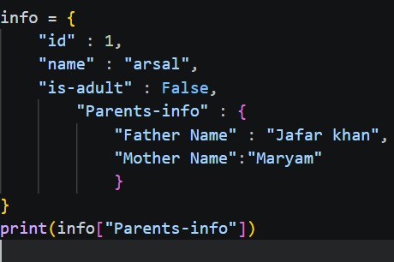
Nested Dictionaries

Slide 8
QUESTION 1: Write a program to store following word meanings in a python dictionary : table : “a piece of furniture”,“list of facts & figures” cat : “a small animal”
SOLUTION:
dict = {
"table" : "a piece of furniture,list of facts & figures",
"cat" : "a small animal"
}
print(dict)

Slide 9
QUESTION 2: Write a program to enter marks of 3 subjects from the user and store them in a dictionary. start with an empty dictionary & add one by one. use subject name as key & marks as value.
mydict = {}
mydict["English"] = int(input("Enter English marks: "))
mydict["Maths"] = int(input("Enter Maths marks: "))
mydict["Geography"] = int(input("Enter Geography marks: "))
print(mydict)

Slide 10
QUESTION 3: AI systems that predict your grade, loan approval, or job selection all work on stored rules. Today we build one!
# Grade rules stored like an AI model's decision table
grade_rules = {
"A": 80,
"B": 65,
"C": 50,
"D": 40
}
name = input("Enter student name: ")
marks = int(input("Enter marks out of 100: "))
# AI decision making using dictionary if marks >= grade_rules["A"]: print(name + " got Grade A - Excellent!") elif marks >= grade_rules["B"]: print(name + " got Grade B - Good!") elif marks >= grade_rules["C"]: print(name + " got Grade C - Average") elif marks >= grade_rules["D"]: print(name + " got Grade D - Below Average") else: print(name + " got Grade F - Fail")

Slide 11
QUESTION 4: Every shopping app like daraz uses a price dictionary in the background. Let's build a mini version!
# Product database - like an AI shopping system
shop = {
"rice": 120,
"sugar": 90,
"oil": 350,
"flour": 80,
"milk": 160
}
print("Available items:", list(shop.keys()))
print("-----------------------------")
total = 0
shopping_list = []
item1 = input("Enter item 1: ").lower()
qty1 = int(input("Enter quantity: "))
item2 = input("Enter item 2: ").lower()
qty2 = int(input("Enter quantity: "))
# Calculate bill using dictionary prices
if item1 in shop:
total = total + shop[item1] * qty1
shopping_list.append(item1)
else:
print(item1 + " is not available in store")
if item2 in shop:
total = total + shop[item2] * qty2
shopping_list.append(item2)
else:
print(item2 + " is not available in store")
print("-----------------------------")
print("Items bought:", shopping_list)
print("Total Bill: Rs." + str(total))
#Bonus - AI style recommendation
if total > 500:
print("AI Tip: You qualify for FREE delivery!")
else:
print("AI Tip: Add more items to get free delivery!")

Slide 12
THE END

